Slide 1
Topics in Vector Calculus
Chapter 15

Slide 2
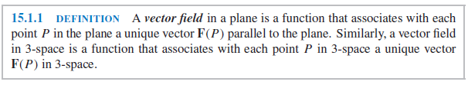


Slide 3
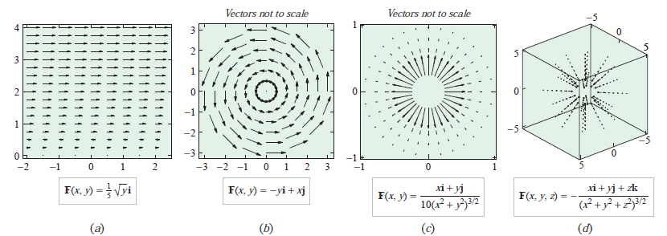

Slide 4
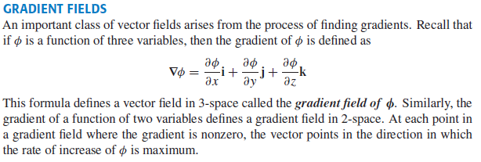
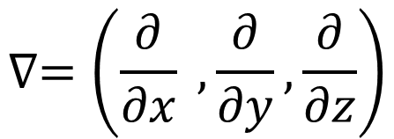
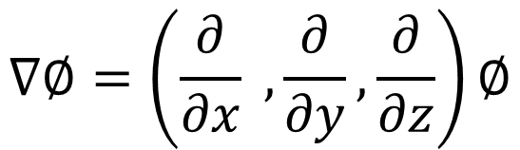
$$∇=\left(\frac{∂}{∂x} , \frac{∂}{∂y},\frac{∂}{∂z}\right)$$
$$∇∅=\left(\frac{∂}{∂x} , \frac{∂}{∂y},\frac{∂}{∂z}\right)∅$$

Slide 5


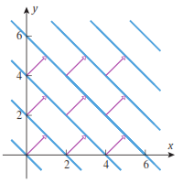

Slide 6
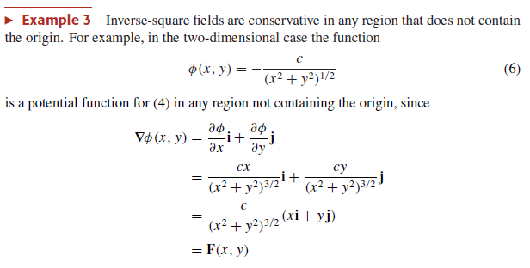

Slide 7
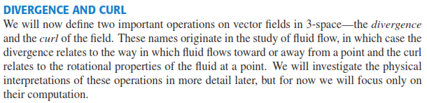
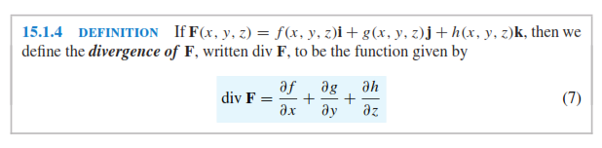
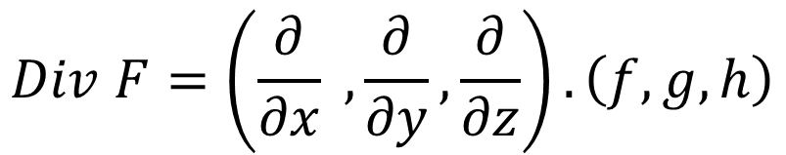

$$Div F=∇.F$$
$$Div F=\left(\frac{∂}{∂x} , \frac{∂}{∂y},\frac{∂}{∂z}\right).\left(f,g,h\right)$$

Slide 8
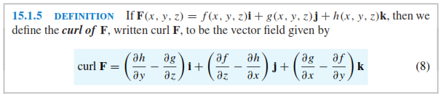

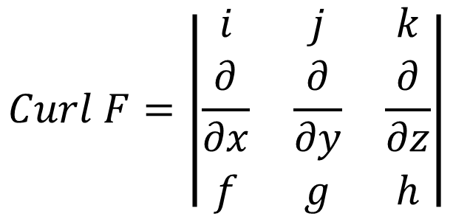
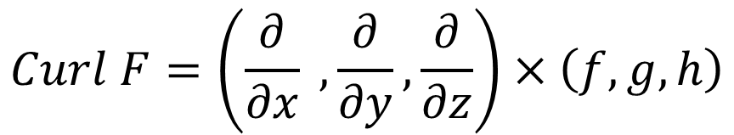
$$Curl F=∇×F$$
$$Curl F=\left(\frac{∂}{∂x} , \frac{∂}{∂y},\frac{∂}{∂z}\right)×\left(f,g,h\right)$$
$$Curl F=\left|\begin{matrix}i & j & k \\ \frac{∂}{∂x} & \frac{∂}{∂y} & \frac{∂}{∂z} \\ f & g & h\end{matrix}\right|$$

Slide 9
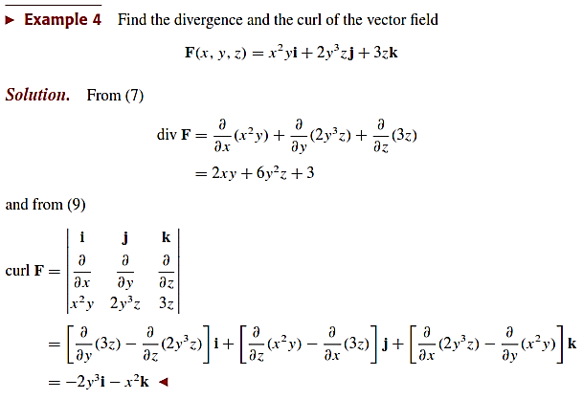

Slide 10
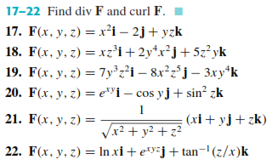

Slide 11
Line Integral

Slide 12
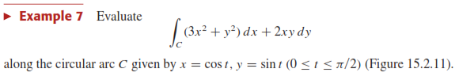









Slide 13
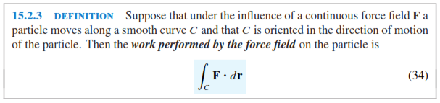

Slide 14
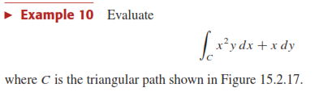
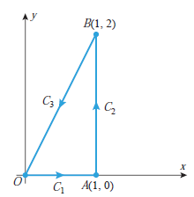


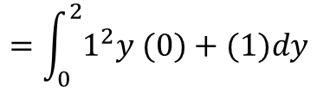


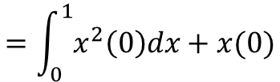
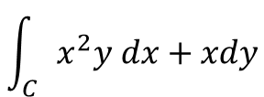


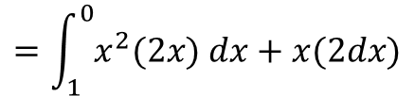
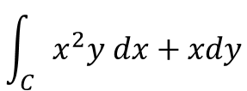


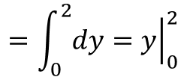


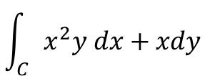



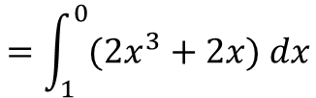
$$Along curve C1$$
$$y=0$$
$$→ dy=0$$
$$Along curve C2$$
$$\int_{C}{x^{2}y dx+xdy}$$
$$=\int_{0}^{1}{x^{2}\left(0\right)dx+x(0)}$$
$$y=2x$$
$$→ dy=2 dx$$
$$=0$$
$$\int_{C}{x^{2}y dx+xdy}$$
$$=\int_{1}^{0}{x^{2}(2x) dx+x(2dx)}$$
$$Along curve C2$$
$$x=1$$
$$→ dx=0$$
$$=\int_{1}^{0}{(2x^{3}+2x) dx}$$
$$\int_{C}{x^{2}y dx+xdy}$$
$$=\int_{0}^{2}{1^{2}y (0)+(1)dy}$$
$$=−1.5$$
$$=\int_{0}^{2}{dy}={\left.y\right|}_{0}^{2}$$
$$=2$$

Slide 15

